Slide 1
Design a webpage for online food delivery system using HTML and CSS
TS - WEB TRACK CAPSTONE PROJECT
Presented By:
1. Miss Shravani Siripuram – SCITS Karimnagar(CSE B-Tech)
2. Miss Sufiya Farooqi – SCITS Karimnagar(CSE B-Tech)
3. Miss Shyamakura Laxmi – SCITS Karimnagar(CSE B-Tech)
4. Miss Spandana Kethiri – SCITS Karimnagar(CSE B-Tech)
Guided By: Ms. Vidhi Pandya

Slide 2
CONTENTS
Problem Statement
Abstract
Tools & Technologies
System Requirements
Modules
Design
Gantt Chart
Result
Limitations of Application
Future of Application
Role of Team Members
Conclusion
References

Slide 3
Problem Statement
The online food ordering system sets up a food menu online
and customers can easily place the order as per they like.
Also, the online customers can easily track their orders.
The management maintains customer’s database.
And improve Food delivery service.
This system also provides a feedback system in which user can rate the food items.

Slide 4
Abstract
Online food ordering is a feature of our suggested system, which makes it convenient for customers.
Our system is an easy way to order food from restaurants and get a mess service online.
This system enhances the process of taking consumer orders. Customers can easily place orders.
Additionally, this system has a feedback feature .
Both online and pay-on-delivery payment methods are available.
It gives each user a unique ID and password, separate accounts are maintained.

Slide 5
Tools & Technologies
Tools
GloriaFood
Toast POS
Menu Drive
VS Code
Technologies
HTML
CSS
Java Script

Slide 6
System Requirements
Software Requirements
Operating System : Windows 11
Software Tool : VS Code
Web Browser : Google chrome, Brave etc..
Hardware Requirements
Processor : Intel Core i3.
Memory : 512 SSD.
Ram : 8 GB.

Slide 7
MODULES
Food Item Management Module: Used for managing the Food Item details.
Confirm Order Module : Used for managing the details of Confirm Order
Payment Module : Used for managing the details of Payment
Customer Module : Used for managing the Customer details
Order Module : Used for managing the Order information’s
Login Module: Used for managing the login details
Users Module : Used for managing the users of the system

Slide 8
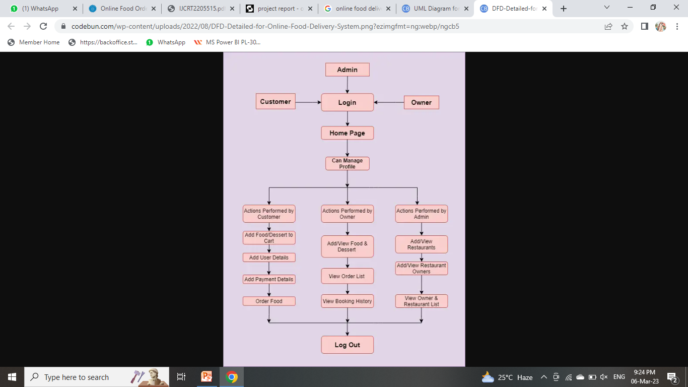
DESIGN
Data Flow Diagram of Application:

Slide 9
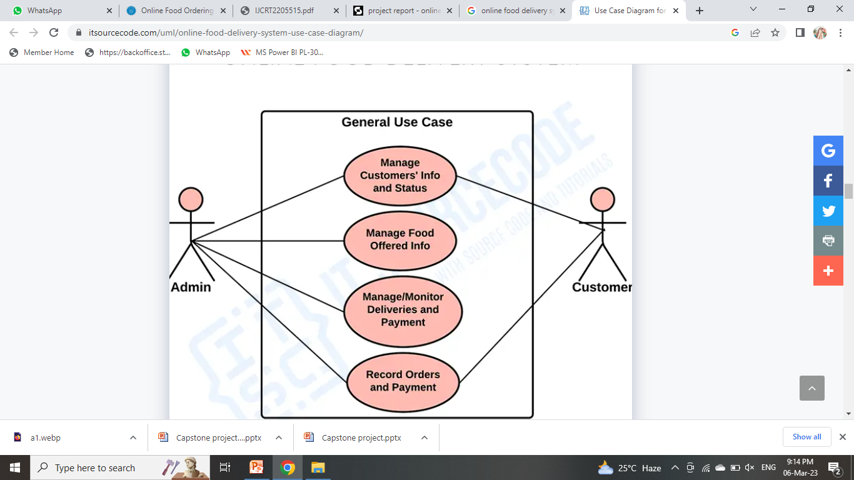
Use-Case Diagram:

Slide 10
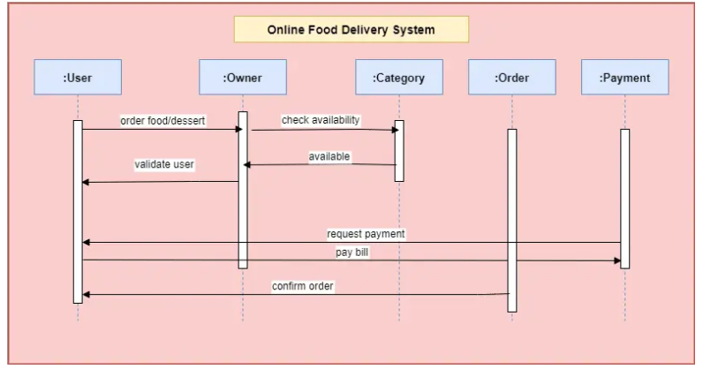
Sequence Diagram:

Slide 11
Gantt Chart
Task | December |  |  |  | January |  |  |  | February |  |  |  | March
 | 1st Week | 2nd Week | 3rd Week | 4th Week | 1st Week | 2nd Week | 3rd Week | 4th Week | 1st Week | 2nd Week | 3rd Week | 4th Week | 1st Week | 2nd Week | 3rd Week | 4th Week
Requirement Analysis
Assignment
Design
Product Page design
Individual product Design
Content page design
Static Page Design
Homepage Coding
Product line page Coding
Individual product coding
Content page coding
Static page coding
Product Upgrading
Testing
Deployment

Slide 12
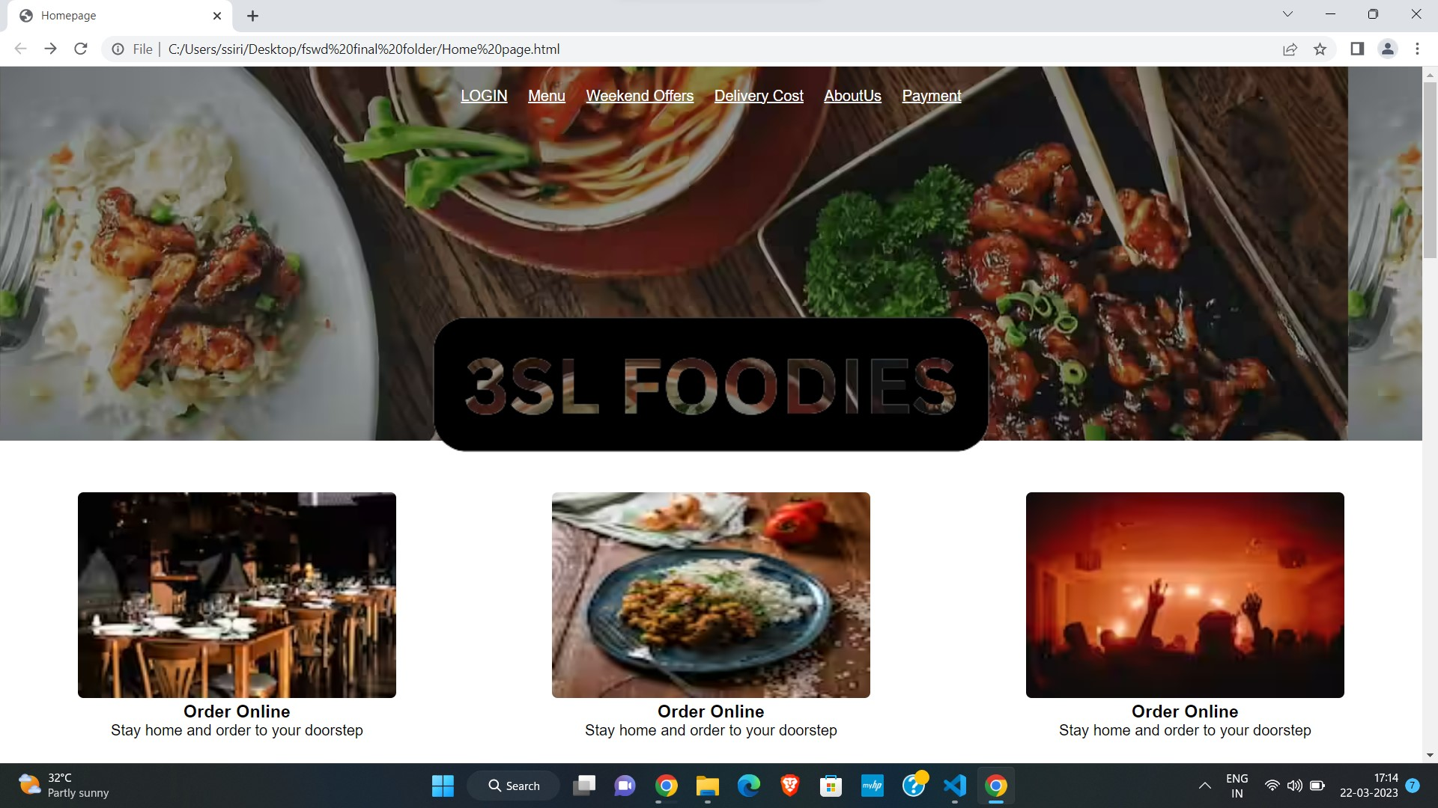
Result

Slide 13
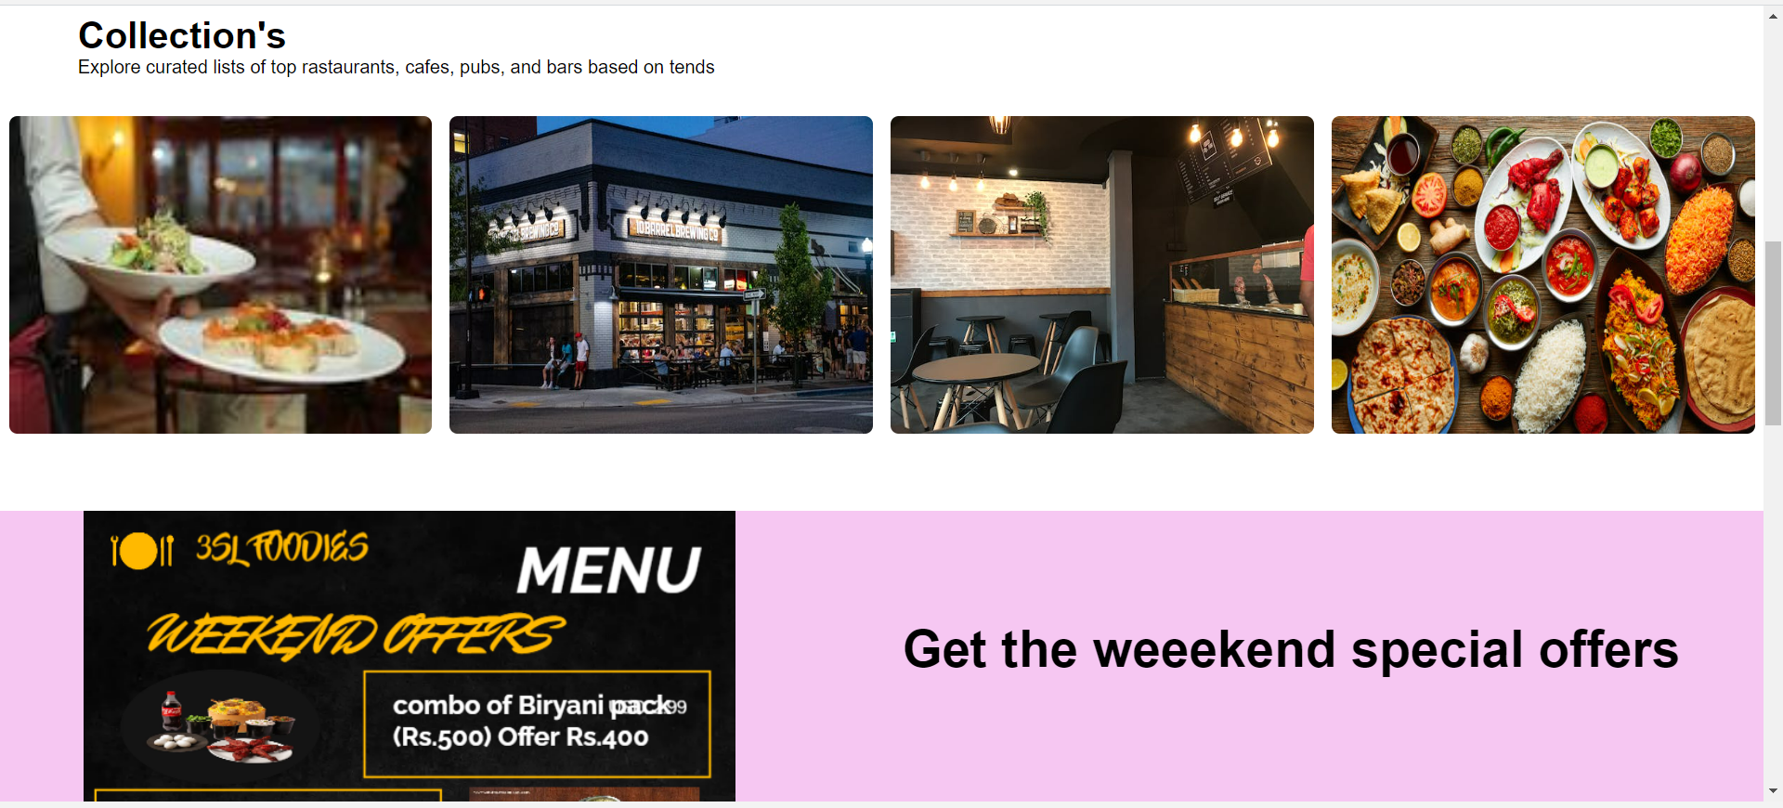
Result

Slide 14
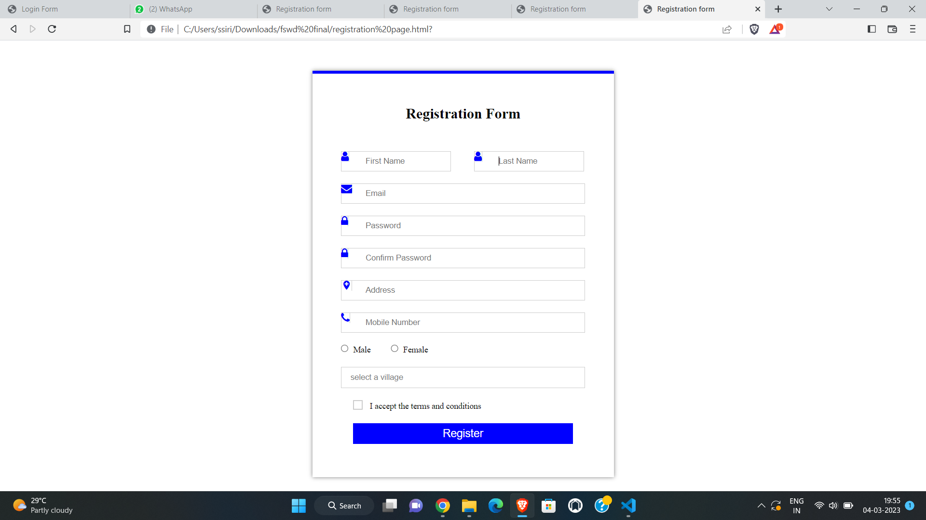
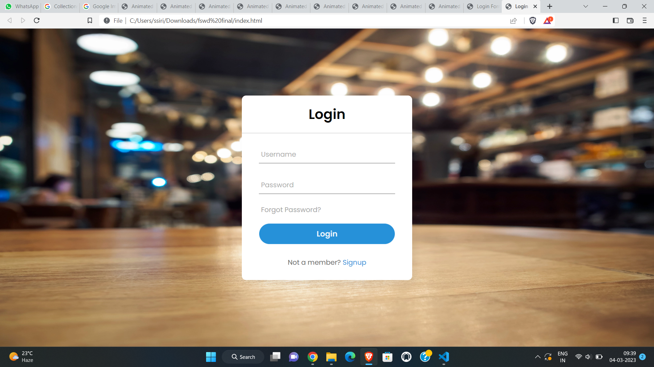
Result

Slide 15
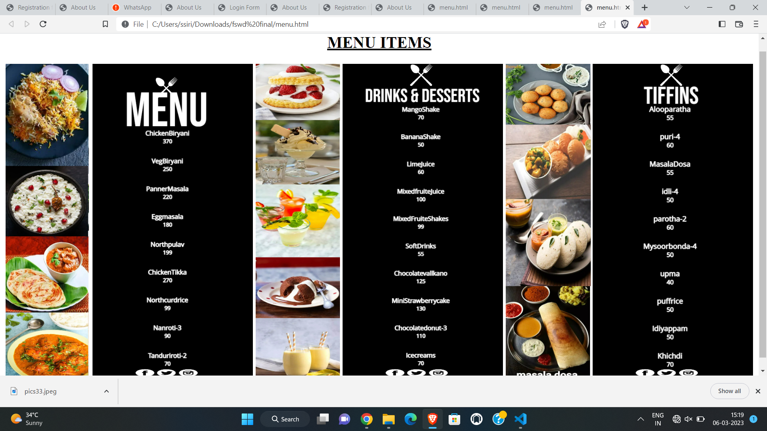
Result

Slide 16
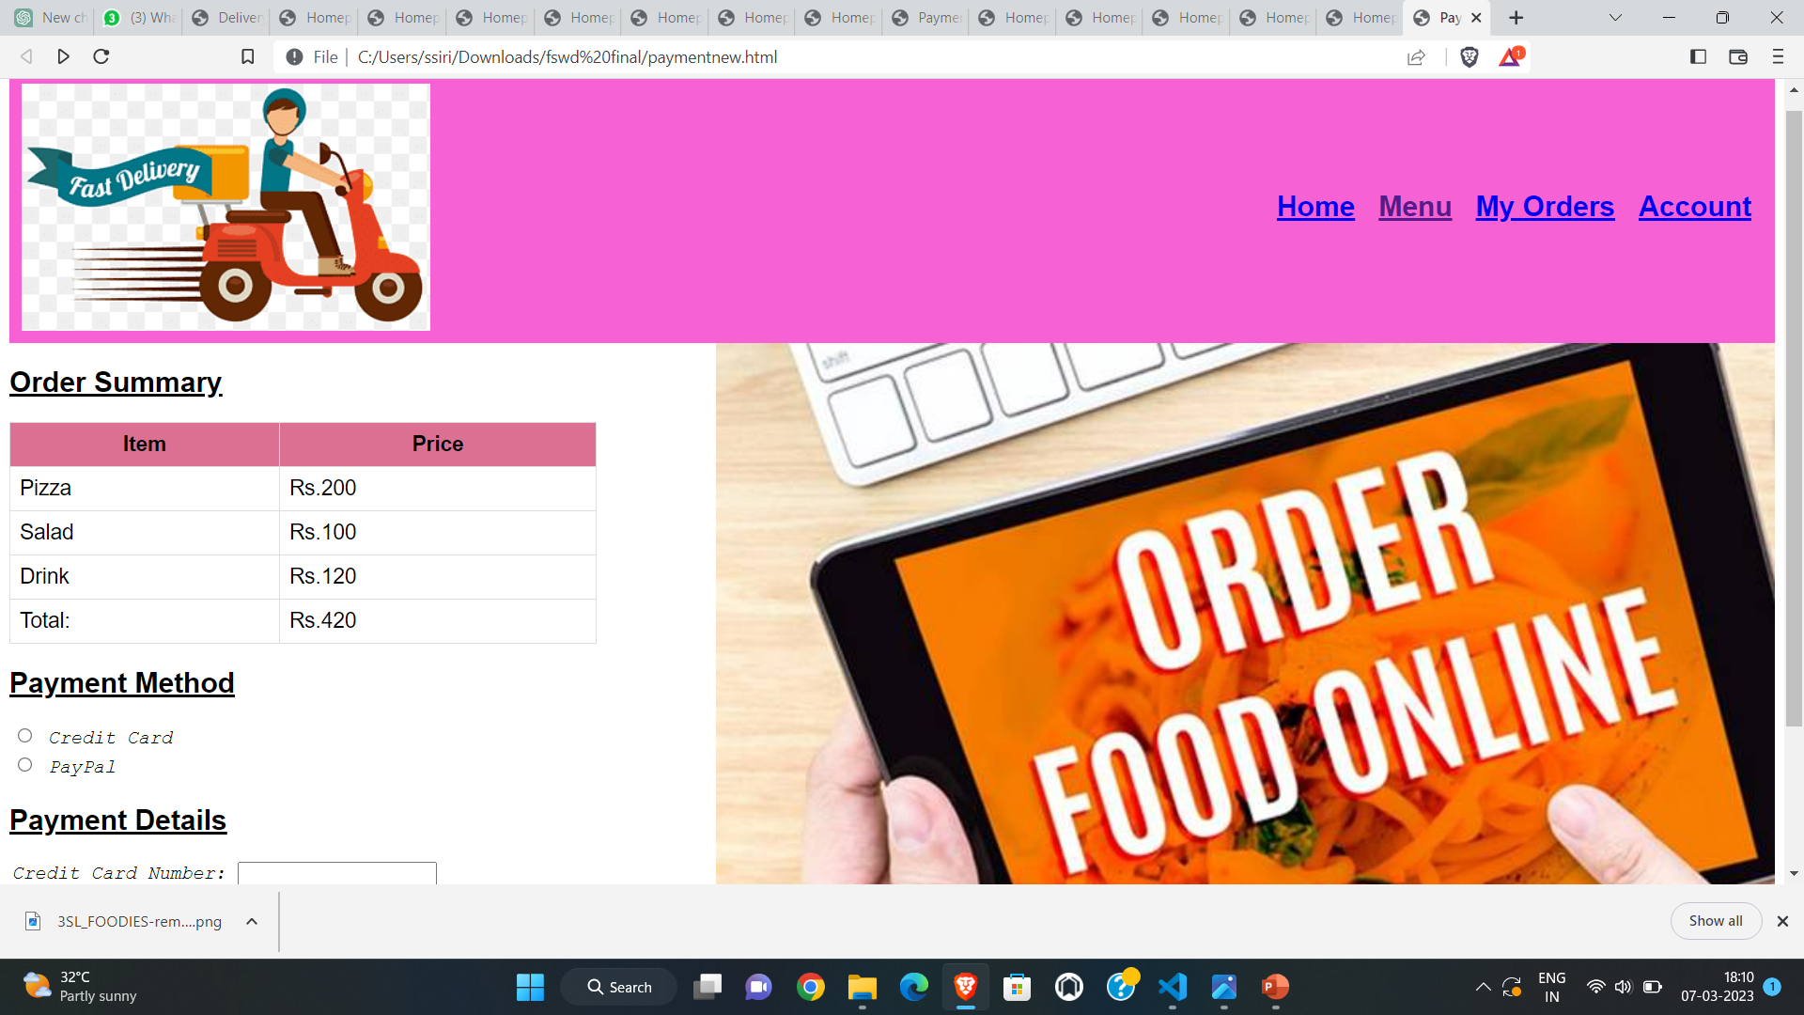
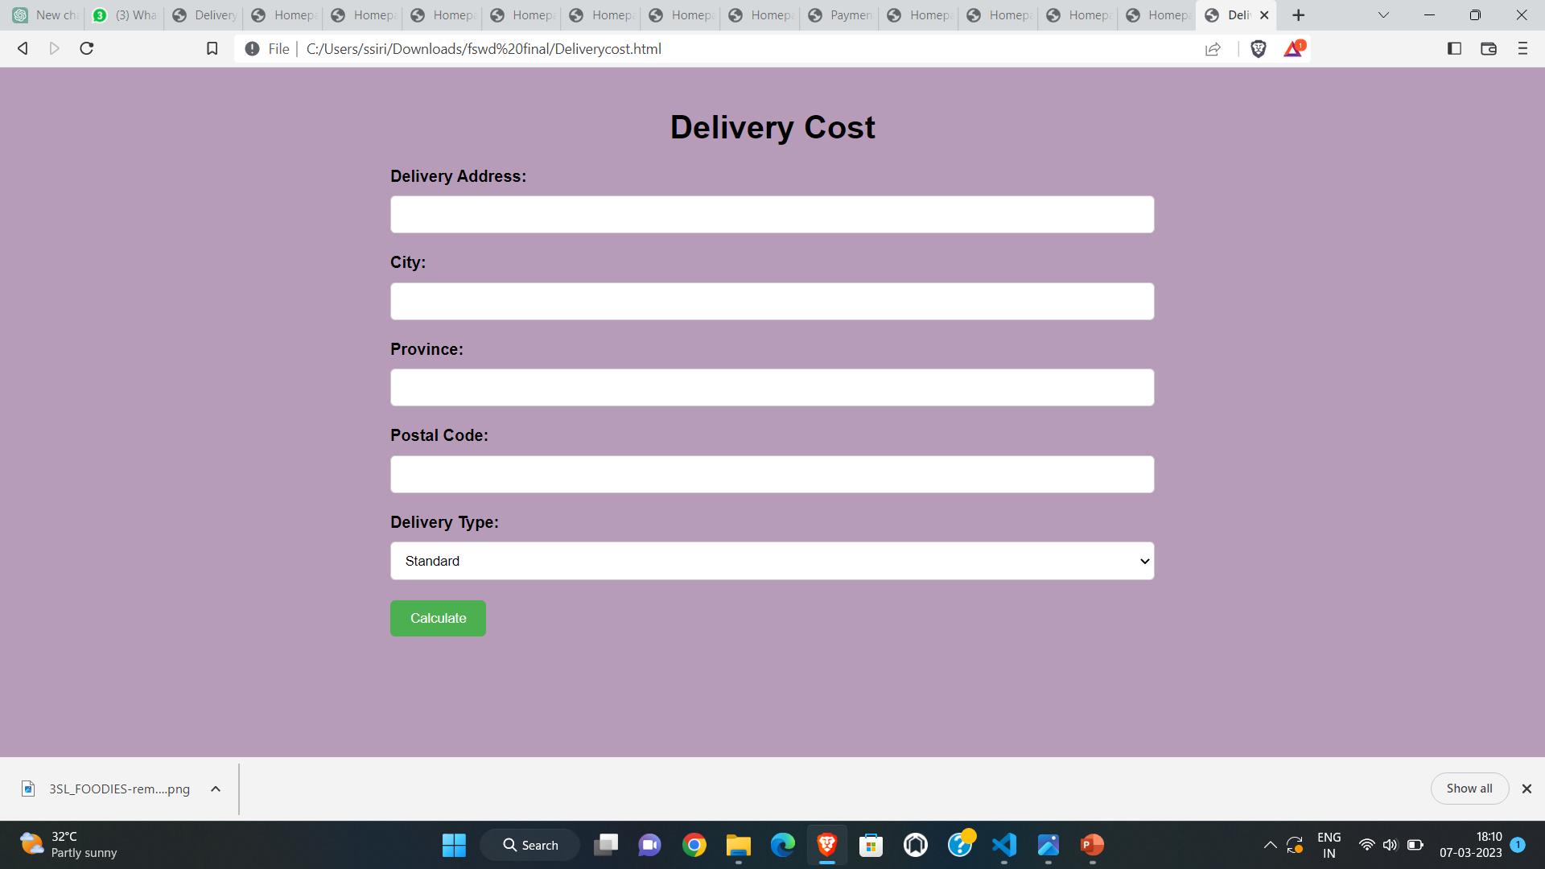
Result

Slide 17
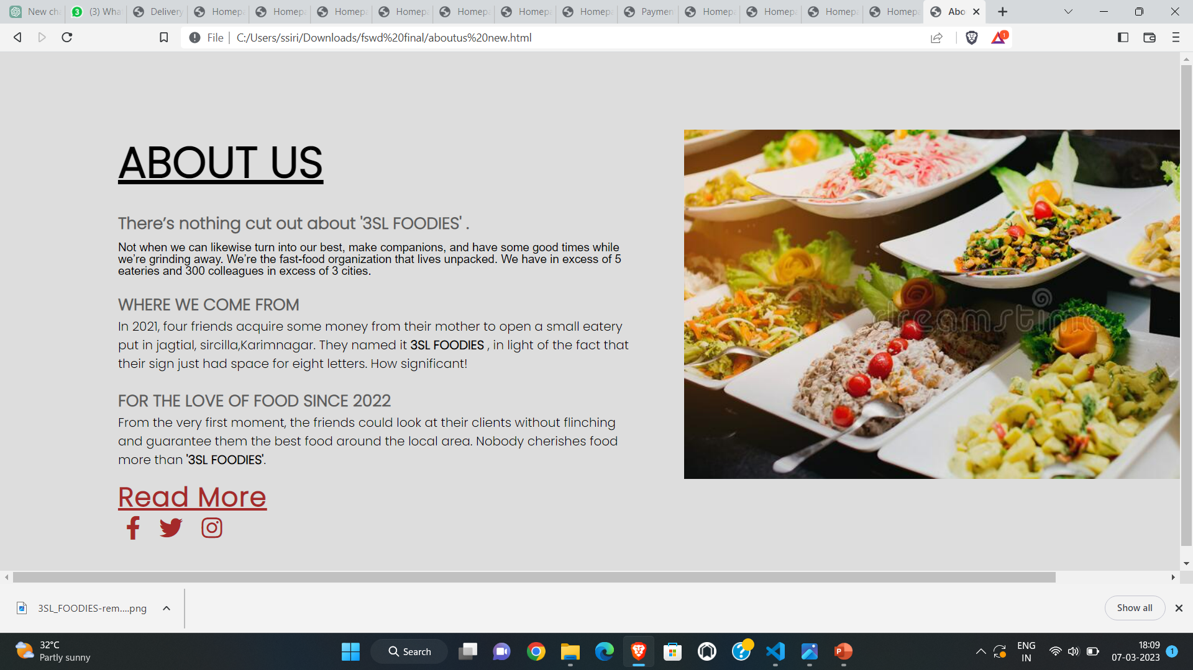
Result

Slide 18
Limitations of Application
Security
Lack of Privacy
Tax Issue
Fear
Product Suitability
Cultural Obstacles
High Laboure Cost
Legal Issues
Technical Issues
Huge Technological Cost
Delivery Guarantee

Slide 19
Future of Application
• We will add printer in future.
• We will offer additional advance package for on-line Food Ordering System as well as additional facilities.
• We can host the platform on on-line servers to create it accessible worldwide.
• Integrate multiple load balancers to distribute the masses of the system.
• Implement the backup mechanism for taking backup of codebase and info on regular basis on totally different servers.

Slide 20
Role of Team Members
S . Shravani – Web Designer , Code Execution & Builder , PPT Developer, Report maker
Sufiya farooqi – Web Designer , PPT Developer , Analyser, Report maker
S . Laxmi – Supporter, PPT Developer , Designer, Report maker
K . Spandana – Supporter, PPT Developer , Designer, Report maker

Slide 21
CONCLUSION
An online food ordering system has been planned wherever the purchasers will create associate or orders the food.
The exploitation of the application, the tip users register online, scan the E-menu card, and choose the food from the e-menu card to order food online.
Once the client selects the desired food item the cook is going to be ready to see the results on the screen and begin to process the food.
This application nullifies the requirement of a waiter or reduces the employment of the waiter.
The advantage is that in a very jammed eating place there will be the probability that the waiters are overladen with orders and that they are unable to fulfill the wants of the client in a very satisfactory manner.

Slide 22
References
https://www.studocu.com/in/document/visvesvaraya-technological-university/mcaassignsemester-i/project-report-online-food-delivery/16570334
https://www.ijraset.com/research-paper/online-food-ordering-system#conclusion
https://ijcrt.org/papers/IJCRT2205515.pdf

Slide 23
Thank you…..

